Slide 1






Slide 3
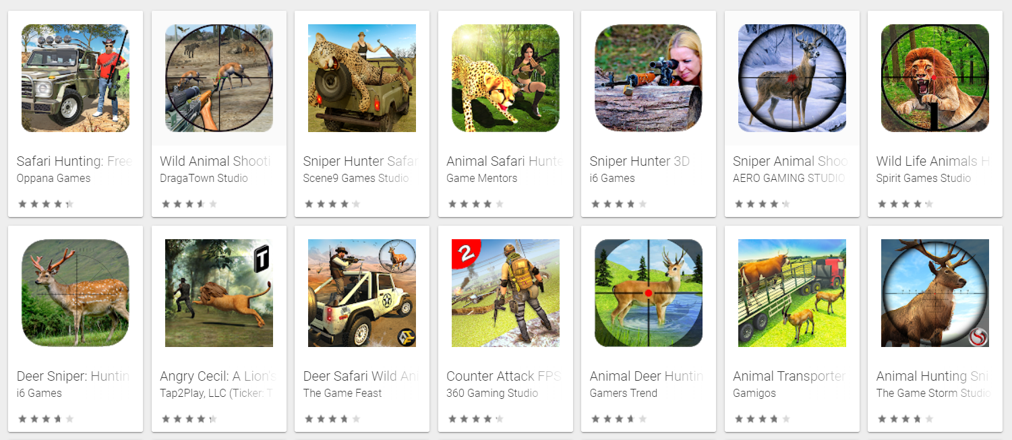


Slide 4
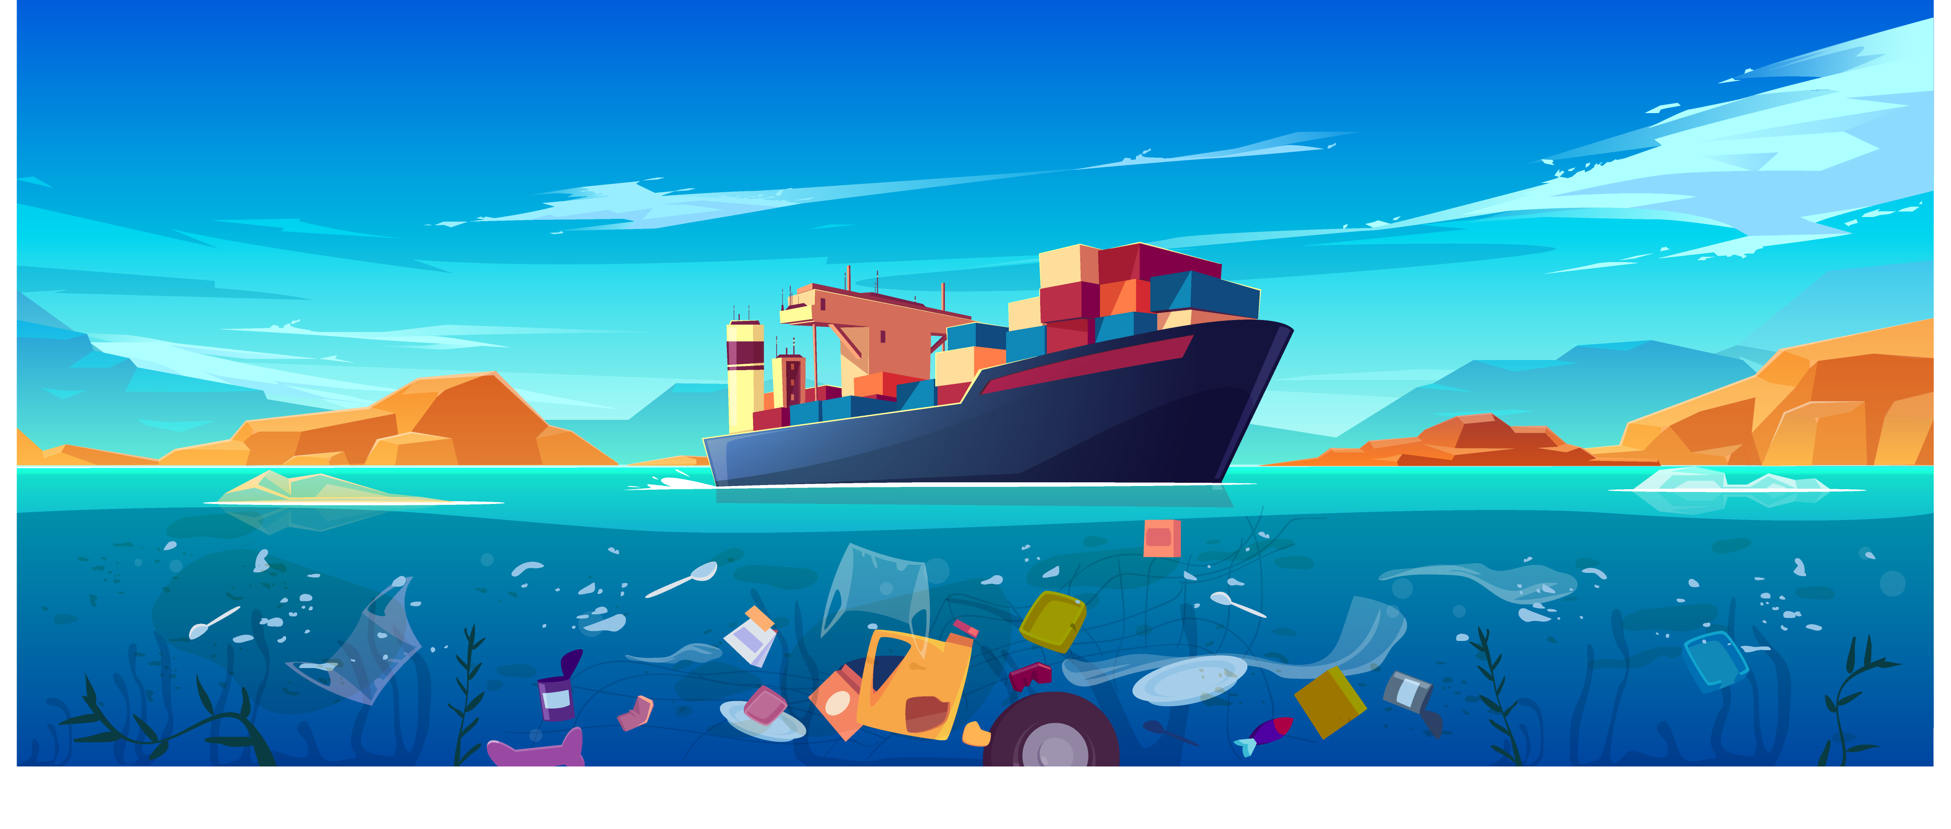

WE ARE THE
WE ARE THE
PROBLEM!
PROBLEM!

Slide 5

People are IGNORANT,
UNTRAINED,
DESTRUCTIVE of surroundings,
TOLERANT of BAD BEHAVIOR,
and INACTIVE in communities
To solve this problem;
we CREATED A GAME.

Slide 6


Slide 7



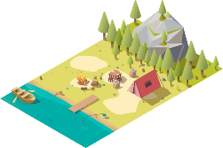

MECHANICS
MECHANICS
Movement in
the Game
Combat
Objects
Actions

Slide 8
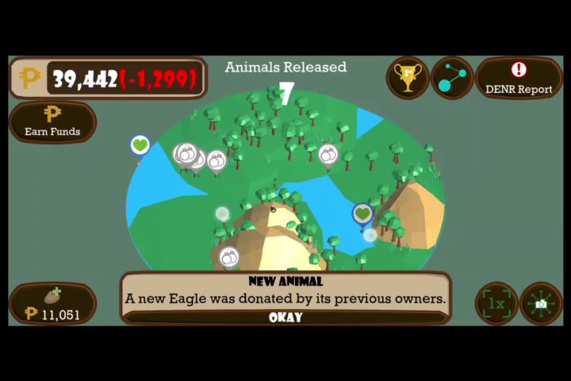

Slide 9
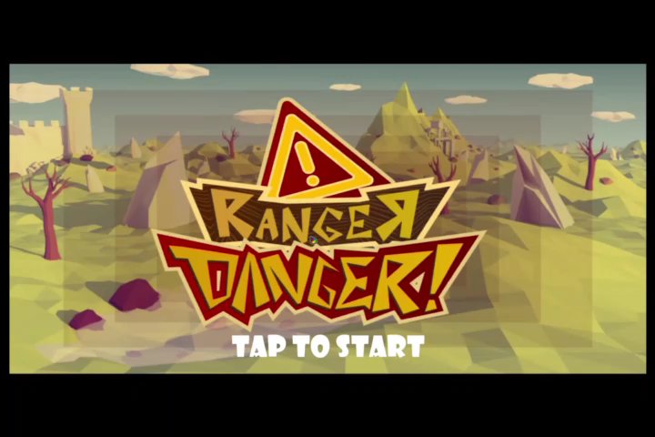

Slide 10
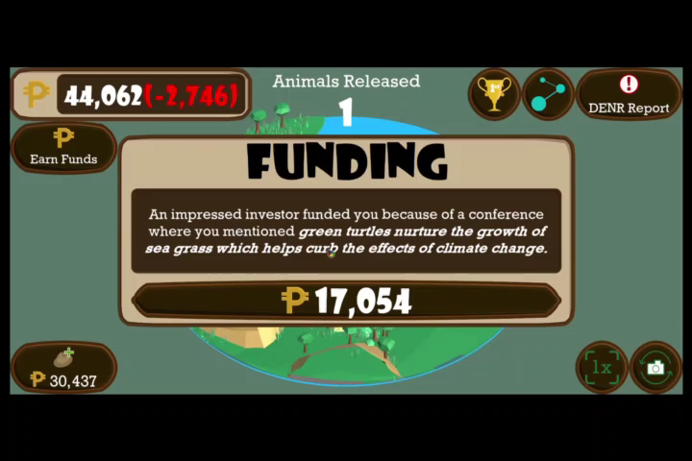

Slide 11
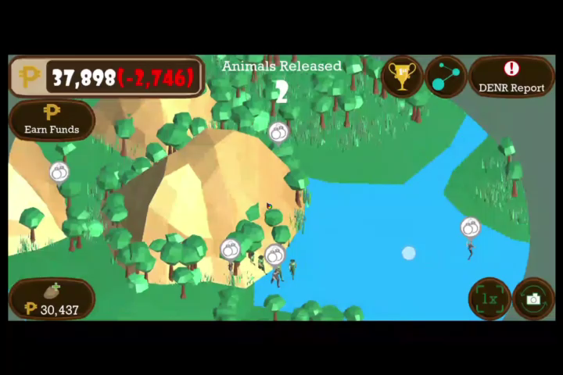

Slide 12







Spread wildlife conservation awareness!
In partnership with
Earn rewards.
PLAY FOR FREE!

Slide 13

OTHER
FEATURES
FEATURES
Built-in reporting feature of
wildlife trafficking and
exploitation.
Partnered with organizations
And institutions.

Slide 14



Slide 15

SOLUTIONS
SOLUTIONS
EDUCATE
PROMOTE
RECREATIONAL
ACTIVITY
TRAIN THE PLAYERS
STIMULATE
INTOLERANCE
OF CRIMES
ENCOURAGE
PROTECTIVE
BEHAVIOR

Slide 16


Tech available today all provide a
temporary short-term solution.
This game targets BEHAVIORAL CHANGE
which is the LONG-TERM SOLUTION.

Slide 17

GOALS
GOALS
Subconscious imprint
Establish awareness
Intrinsic rewards
Altruistic achievement

Slide 18


LOOKING AHEAD
What our team needs to fully develop the game
are funds to compensate those who will take part
in the development, maintenance and upgrade of
the game.
Hardware
Work with wildlife experts to
design accurate scenarios.

Slide 19


GAMES ARE DOWNLOADED MORE OFTEN
THAN REGULAR APPS
BEST APPROACH
A STEP FOR SOLVING NATIONAL PROBLEM OF WILDLIFE TRAFFICKING.
THE RANGER DANGER RESULTS TO BEHAVIORAL CHANGE
THAT IMPACTS ITS USER LONG-TERM

Slide 20


End of presentation
PINE TREE WARRIORS
University of the Cordilleras
ZooHackathon Philippines 2019

